Slide 1
Student Performance Dataset Analysis Using Py Spark
Name: V.Sreeja
Roll No: 2211CS010684 (S1)
Dataset: Student Performance Dataset (Kaggle)
Email: vattikondasreeja4@gmail.com
Linked In:(23) Sreeja Vattikonda | LinkedIn

Slide 2
Introduction
The objective of this project is to analyze various factors that influence student performance, with the ultimate goal of building a predictive model to forecast a student's Exam_Score. The project uses a dataset containing a mix of demographic, academic, and personal factors.

Slide 3
Initial Analysis of the Dataset
Dataset Size: 6,600 users, 20 main columns including demographics, subscription details, and activity information.
Key ColumnsThe key columns in the student performance dataset are: Hours_Studied, Attendance, Parental_Involvement, Access_to_Resources, Extracurricular_Activities, Sleep_Hours, Previous_Scores, Motivation_Level, Internet_Access
Missing Values: Some missing entries in Sleep_Hours, Attendance, Motivation_Level
Duplicates: No duplicates were found in the dataset
Outliers: Outliers were detected in the Age column using a box plot.

Slide 4
Initial Analysis of the Dataset
Basic Statistics:
Average Exam Score: 68
Average Hours Studied:20
Average Sleep Hours: 8
Categorical Distributions:
Gender: Mostly Male and Female
Access To Resources: High> Medium>Low
Internet Access: Yes Or No
Geography: The geographical information for the students is categorized into three main groups: Near, Moderate, and Far.

Slide 5
Dataset Observations
Total records: 6,600 users.
Majority of users are gender Male.
The main target variable, Exam_Score, has a wide range from a minimum of 55 to a maximum of 101, with an average score of 67.75.
Key factors influencing student performance include Hours_Studied, Attendance, and Previous_Scores.
Other important columns are Parental_Involvement, Motivation_Level, Sleep_Hours, and Family_Income.
The geographical data is categorized by Distance_from_Home (Near, Moderate, Far), and the School_Type is either Public or Private.
No duplicate records were found in the dataset, and outliers were detected and handled in the Age column during preprocessing.

Slide 6
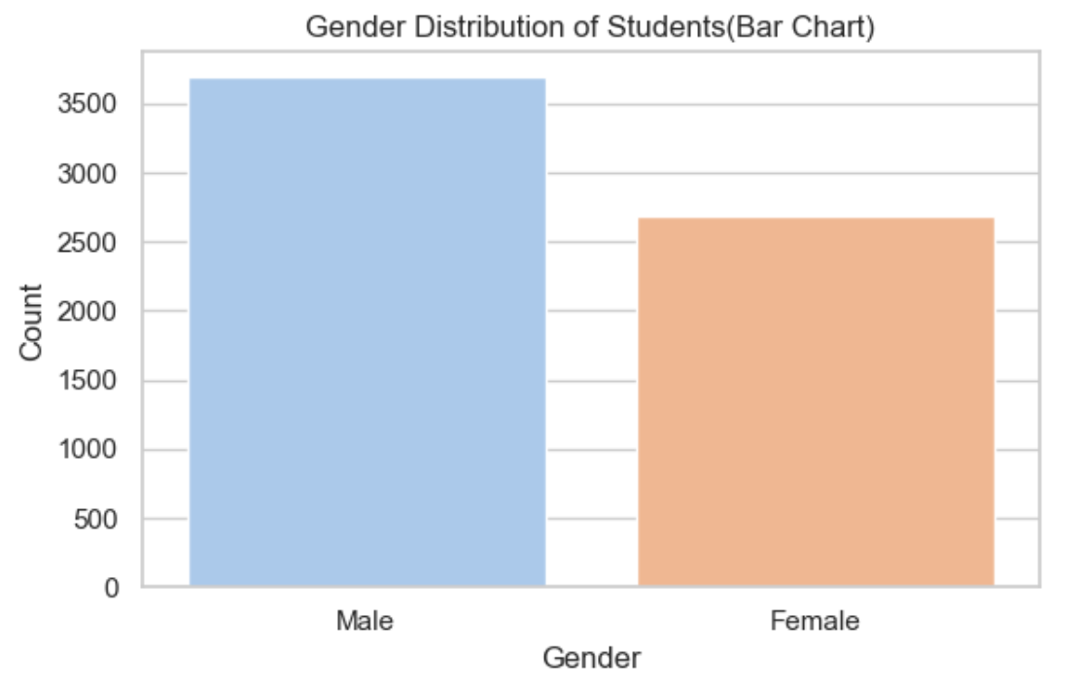
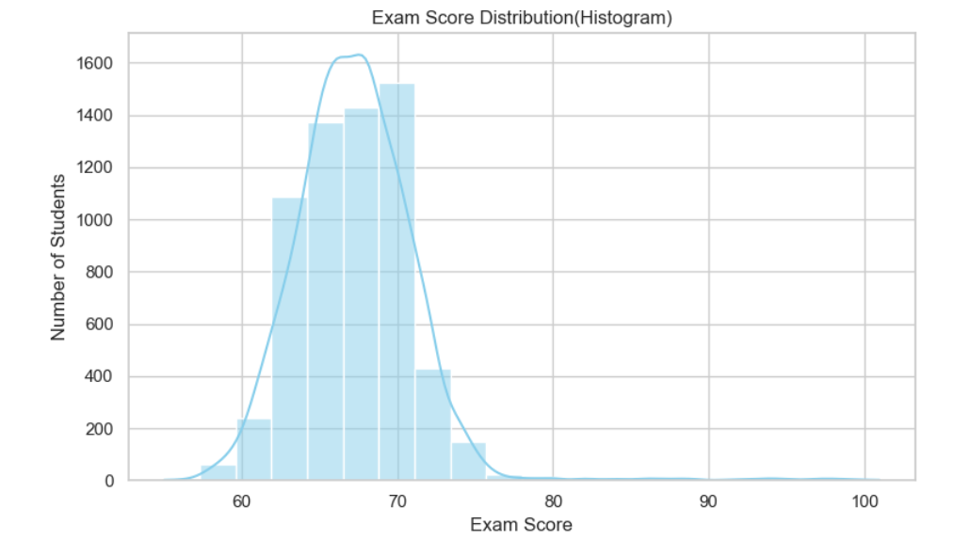
Graphs
1.Histogram: Exam Score Distribution
📊 Observation:
Most students score between 60–80 marks.
Few students below 40 or above 90.
Indicates a moderate difficulty level of exams.
2. Bar Chart: Gender Distribution
📊 Observation:
Nearly equal male and female representation.
Slightly higher male count in dataset.

Slide 7
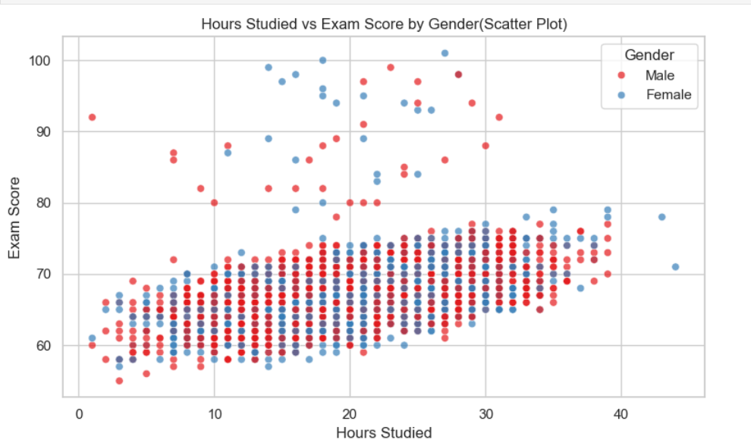
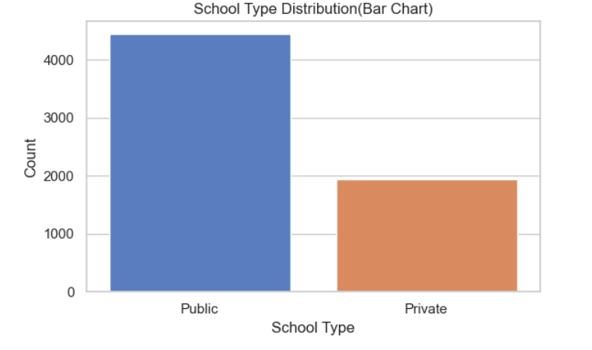
Graphs
3. Bar Chart: School Type Distribution
📊 Observation:
Majority of students belong to government schools.
Private schools form a smaller portion.
4. Scatter Plot: Hours Studied vs Exam Score
📊 Observation:
Positive correlation between hours studied and exam score.
Students studying more than 5 hours/day often score >80.
Outliers suggest study quality also matters.

Slide 8
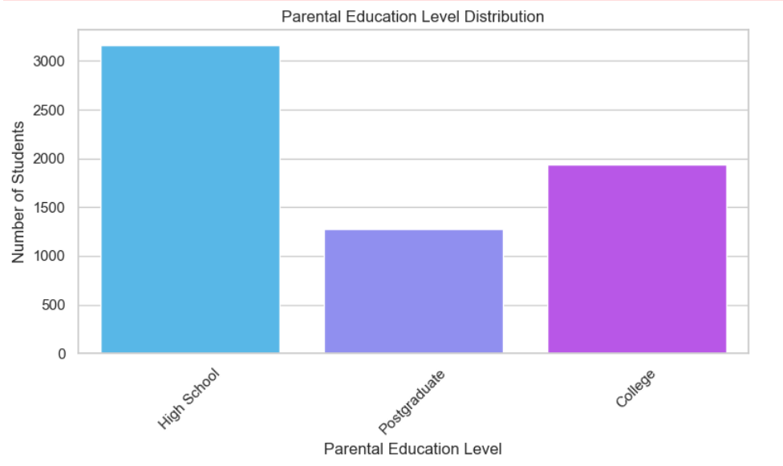
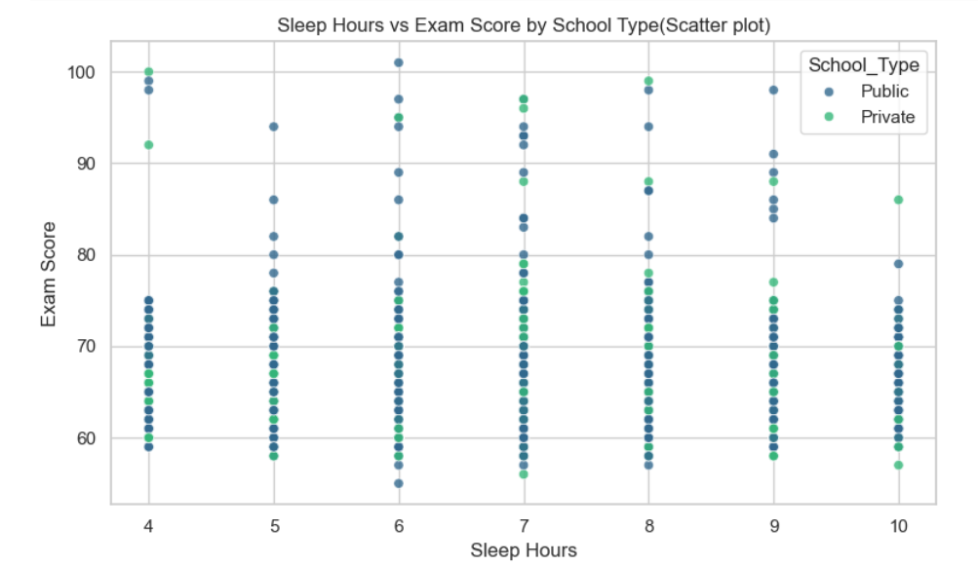
Graphs
5. Scatter Plot: Sleep Hours vs Exam Score
📊 Observation:
Optimal sleep (6–8 hours) correlates with higher exam scores.
Too little (<4 hrs) or too much (>9 hrs) sleep tends to reduce performance.
6. Parental Education Level Analysis
📊 Observation:
Higher parental education often leads to better student performance.
Bachelor’s and Master’s degree parents’ children score higher on average

Slide 9
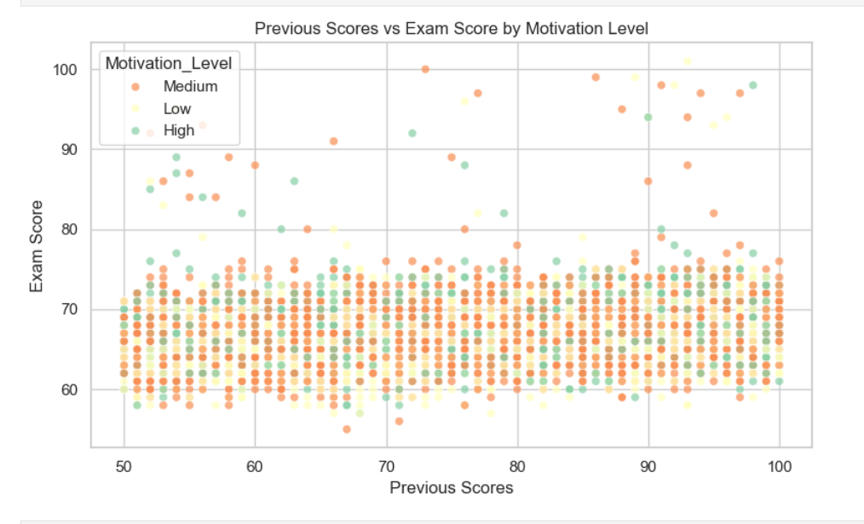
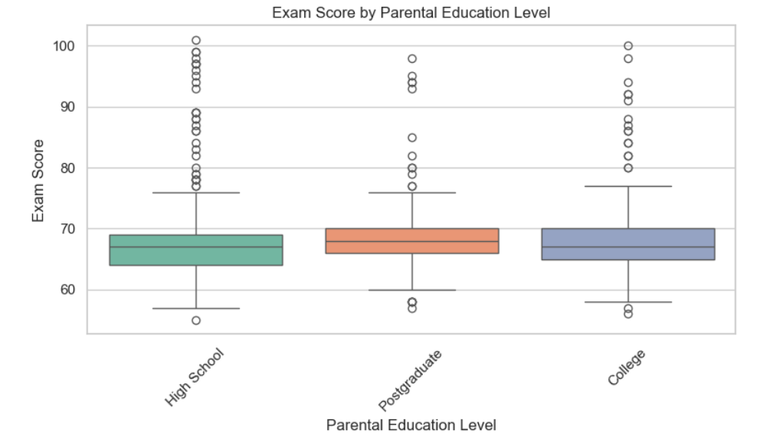
Graphs
7 Box Plot: Exam Score by Parental Education
📊 Observation:
Median exam score rises with parental education.
More variation in students from less educated families.
8. Scatter Plot: Previous vs Exam Score
📊 Observation:
Strong correlation: students with high previous scores generally perform well in exams.
Motivation level enhances this effect.

Slide 10
Conclusion
✅ Findings:
Balanced study and lifestyle habits improve performance.
Encouraging parental involvement and academic motivation are key.
Educational institutions can use these insights for targeted academic support.
🎯 Future Scope:
Apply predictive models (e.g., Linear Regression) using PySpark MLlib.
Expand analysis to real-time student data tracking.

